Slide 1
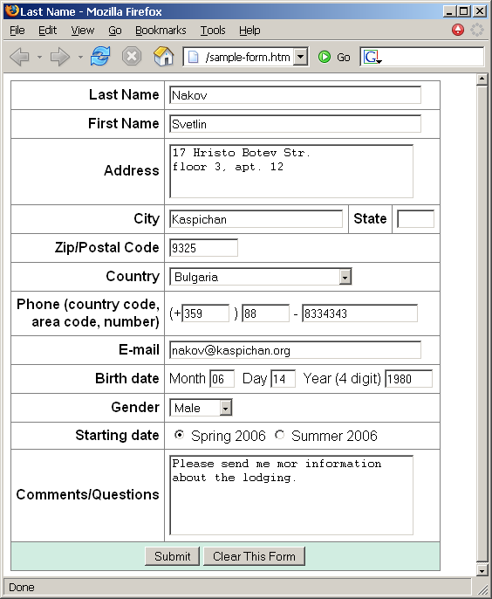
Create a Web form that looks like this sample:

Slide 2
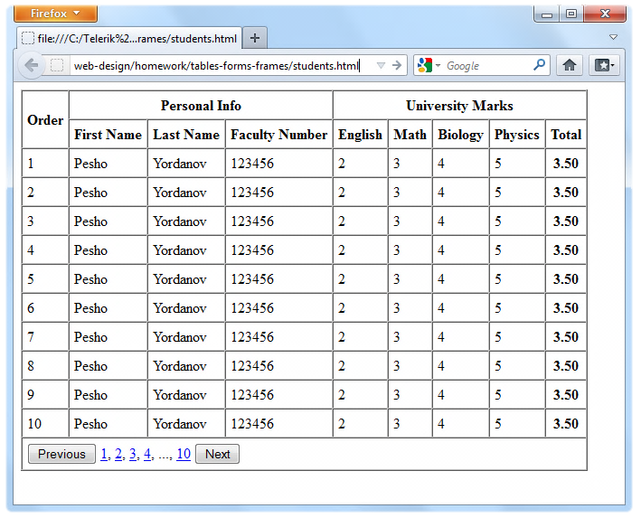
Create the following using tables and forms:

Slide 3
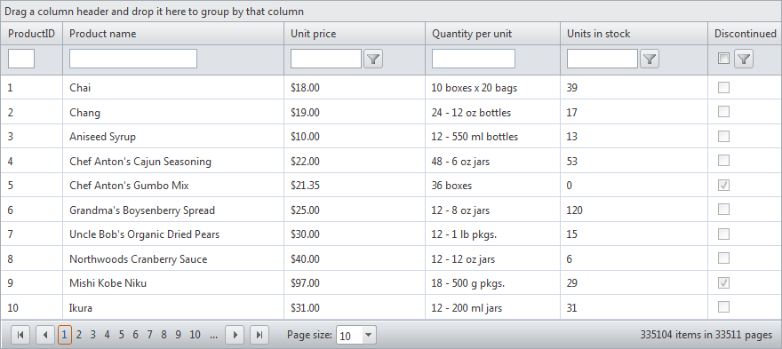
Construct the following Grid component:
Try to make a HTML page, that looks just like the example
Not required to style for the homework

Slide 4
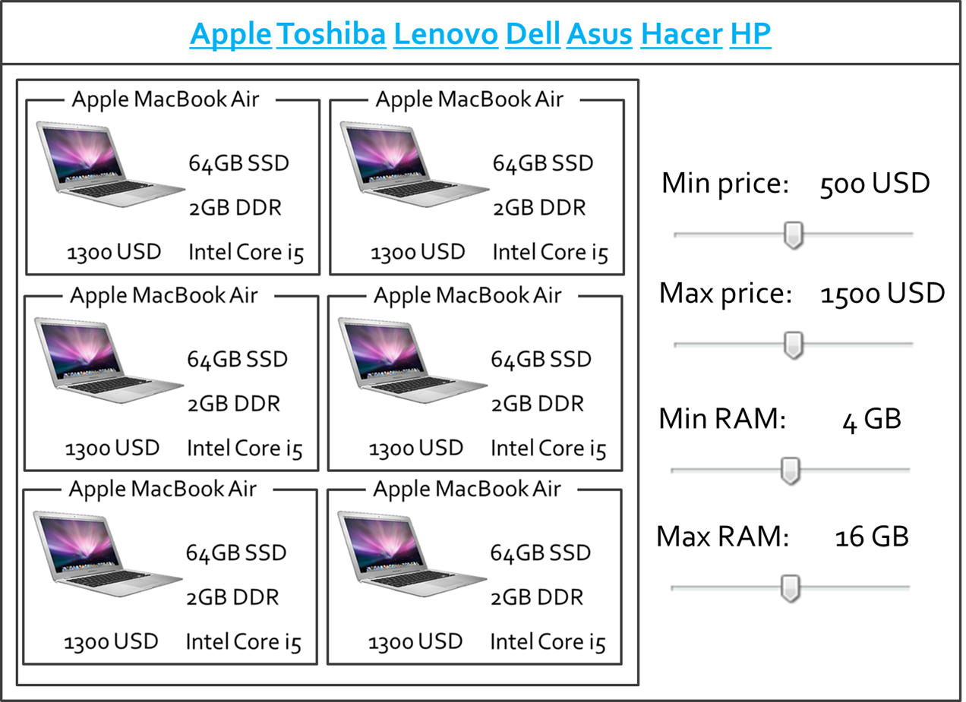
*Create the following HTML Page
Hint: Use Fieldsets and Nested tables

